Slide 1
We ‘Like’ It!
The Impact of Social Media on OD and Learning
Tammy Preble, RadioShack
Rick Palmer, BerylHealth

Slide 2
Tonight’s Agenda
Social Learning Bingo Game
History of Social Learning
The Impact of Social Media on Social Learning
Social Learning in the Workplace
Recommendations and Best Practices

Slide 3
Social Learning Bingo Game
Who has a LinkedIn profile?
Who has over 100 connections on LinkedIn?
Who uses a mobile phone to manage your networking sites?

Slide 4
Social Learning Bingo Game
Who follows more than 20 people on Twitter?
Who has more than 20 followers on Twitter?
Who has “Liked” something in the last 48 hours?

Slide 5
Social Learning Bingo Game
Who participated in the DFW OD Network Scavenger Hunt?
Who believes social media tools are a distraction to learning?
Who can’t imagine life without social media?

Slide 6
What is Social Learning?

Slide 7
Scavenger Hunt Definitions

Slide 8
Social Learning Defined
“[The] result in people becoming more informed, gaining a wider perspective, and being able to make better decisions by engaging with others. It acknowledges that learning happens with and through other people, as a matter of participating in a community, not just by acquiring knowledge.”
Marcia Conner and Tony Bingham
The New Social Learning

Slide 9
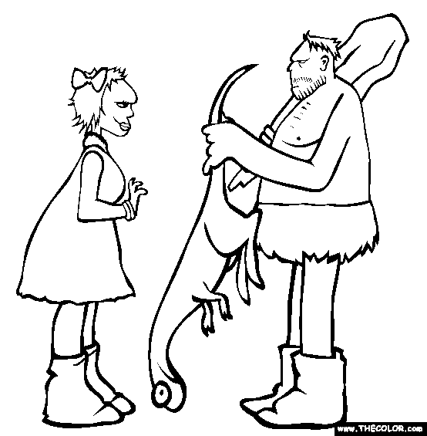
The Origins of Social Learning

Slide 10
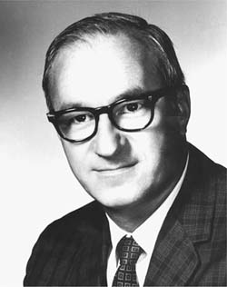
Social Learning Theory
“Most human behavior is learned observationally through modeling: from observing others, one forms an idea of how new behaviors are performed, and on later occasions this coded information serves as a guide for action.”
-Albert Bandura

Slide 11
What are some examples of social learning in the workplace?
Observation
Routine Feedback
Mentoring
Interviews
Peer-to-Peer Learning
Happy Hour!
Appreciative Inquiry
Meetings

Slide 12
What Are the of social Learning?
benefits
Notes:
Flip chart responses.

Slide 13
What Are the of social Learning?
benefits
Risks
Notes:
Flip chart responses.

Slide 14
Social Media

Slide 15
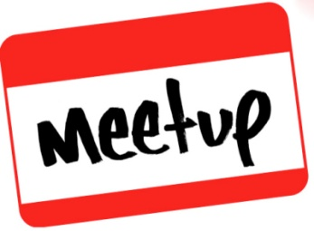
Social Media
web-based and mobile based technologies which are used to turn communication into interactive dialogue between organizations, communities, and individuals.
-wikipedia.com

Slide 16
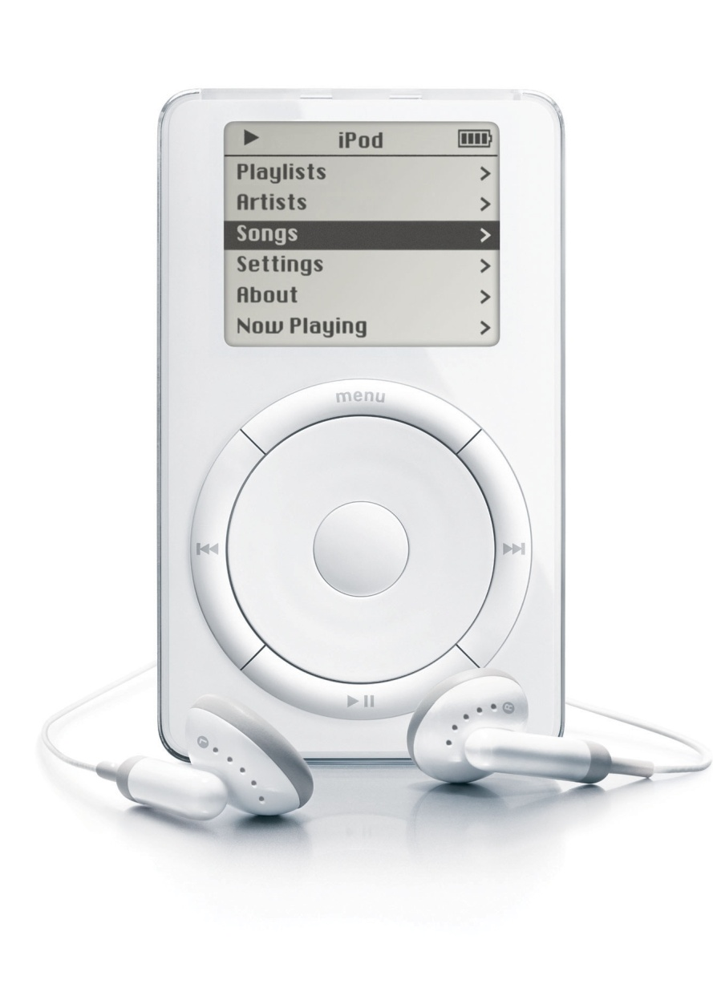
The Gift that Changed My Life

Slide 17
I Hate !

Slide 18
Tips for Tweeting
Have a purpose.
Everything is visible.
Don’t worry about following too many people.
Use hash tags (#) to be found.
#DFWODNet
#OD
#SocialLearning
#AppreciativeInquiry
Use hash tags to search.
Limit tweets to 120 characters.
Shrink URLs.

Slide 20
Leverage LinkedIn Groups
Stay on top of current discussions in your industry.
Expand your reach.
Expand your network.
Post discussions to groups.
Engage in discussions.
Find talent.

Slide 21
Social Learning Case Study
District Manager Training

Slide 22
Social Learning Case Study

Slide 23
Q&A

